Slide 1

Data Analysis insight

Slide 2
Introduction
I will need to evaluate the data to see if it’s accurate and determine the extent to which is possible to support their project.

Slide 3

Jupyter Notebook
What is Jupiter Notebook?
Jupiter notebook is known to be a web application that allows data scientist to write and run codes on its platform. It is used use for various reason such as exploration in data analysis, data cleaning and transformation, statistical cleaning, data visualization, machine learning and deep learning.. Furthermore, Jupyter notebook is compatible with various programming language such as Julia, Haskell, Ruby, python and many other more.

Slide 4

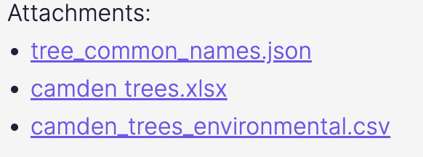
Data sources
I have been given 3 data source to work with to produce my analysis which I have displayed Aboved.

Slide 5
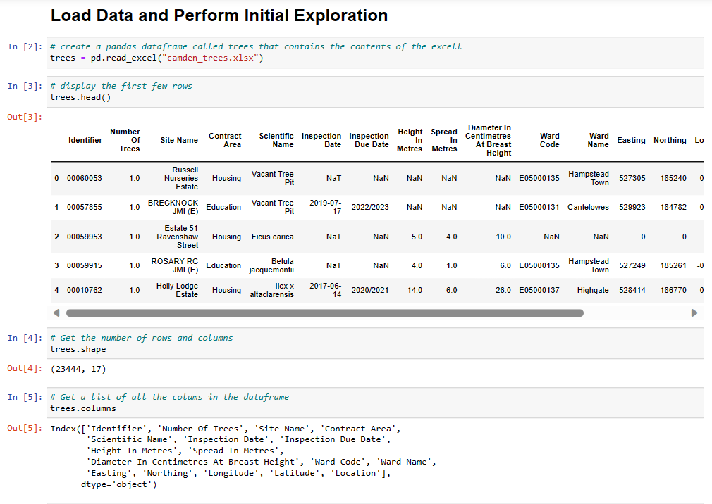
Load and Perform Initial Exploration
Before I loaded the Data into Jupyter notebook, I imported the panda Library so that I can use some of its packages for my analysis. Once this was completed, I then proceed to import my first data source which is the “ Camden_trees.xlsx” data and performed my initial exploration.

Slide 6
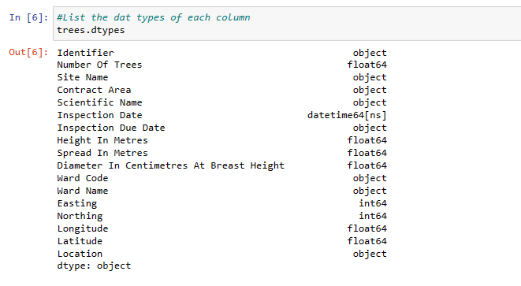
Load and Perform Initial Exploration
This are the data type of each of the colum that are in the “ Camden_trees.xlsx”

Slide 7
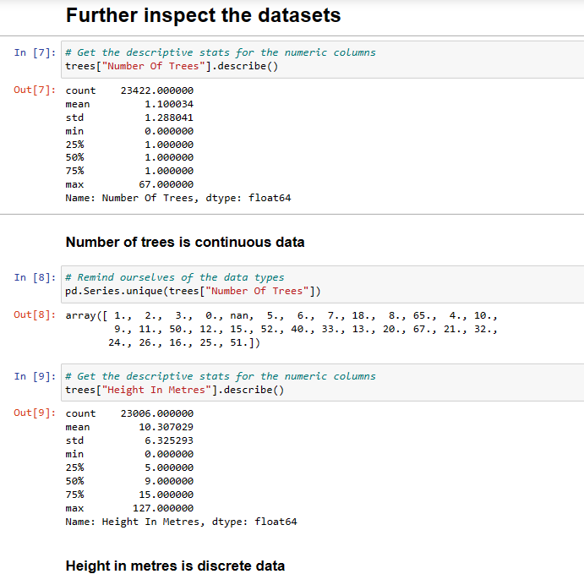
Further Inspection for the Data sets
While I was doing further inspection, I was able to distinguish some some continuous data and discrete data.

Slide 8
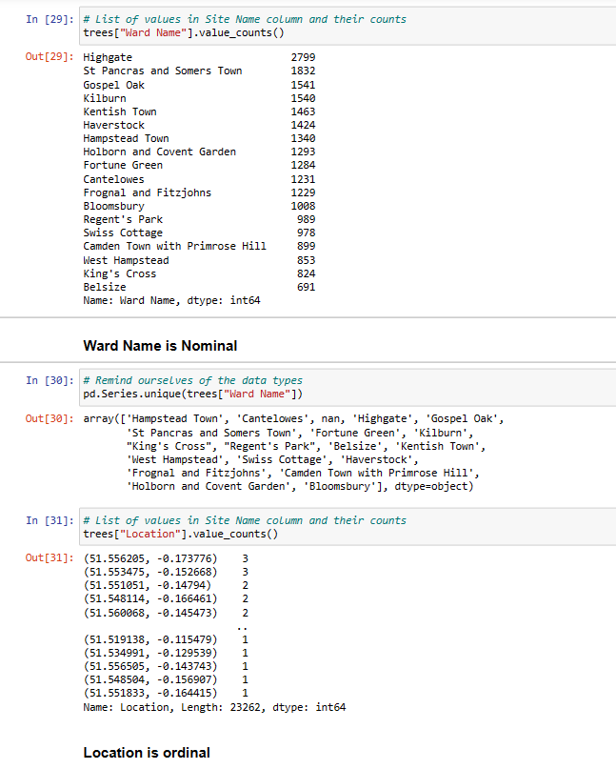
Further Inspection for the Data sets
I was able to differentiate Able to differentiate binary, nominal, or ordinal data through my inspection.

Slide 9
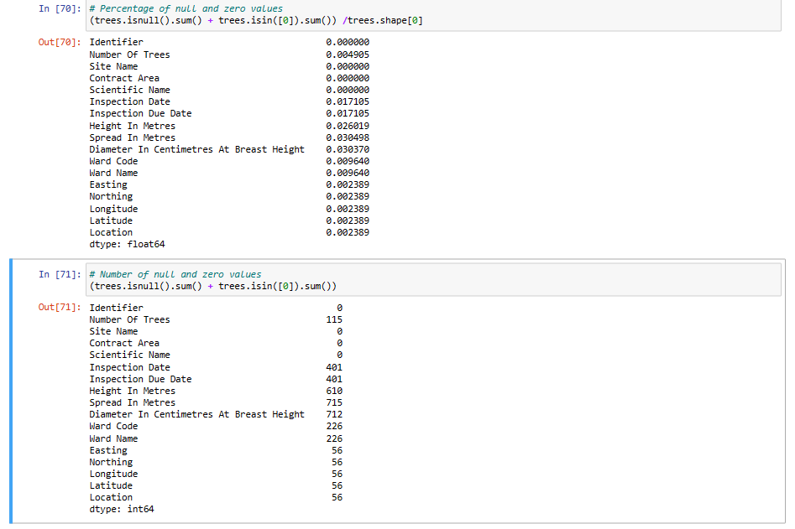
Identify missing values
While I going through my analysis, I was able to identify some missing values for each of my data sources like example for the “Camden_trees.xlsx” source I was able to see a lot of missing data in certain columns such as ‘numbers of tress’ which is 115. However, few columns such as “Site Name” , “Contact Area” and “Scientific Name” had no missing values.

Slide 10
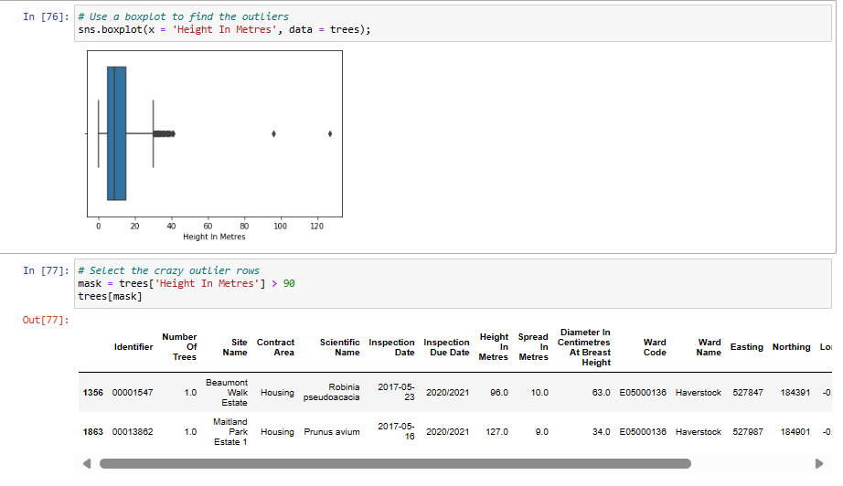
Identify Outlier in the trees Dimension
Outlier for height
While I was going trough my analysis, I was able to find two outliers for height, one for spread and none for diameter using a boxplot tool.

Slide 11
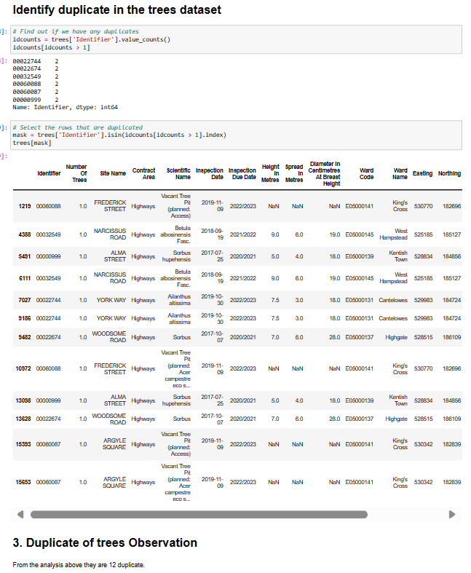
Identify Duplicates in the trees Dataset
While going trough my dataset I was able to distinguish 12 duplicates.

Slide 12
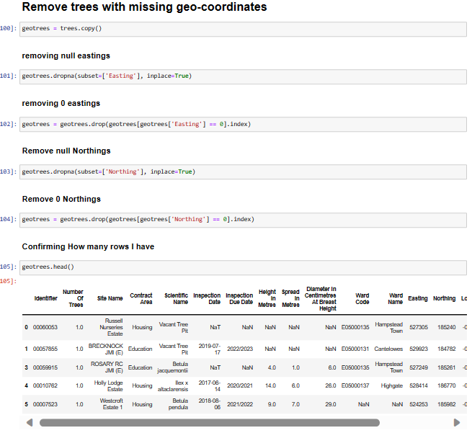
Identify Geolocations issues
In this step I had to remove trees that had missing geo-coordinates, and I was able to find 5.

Slide 13
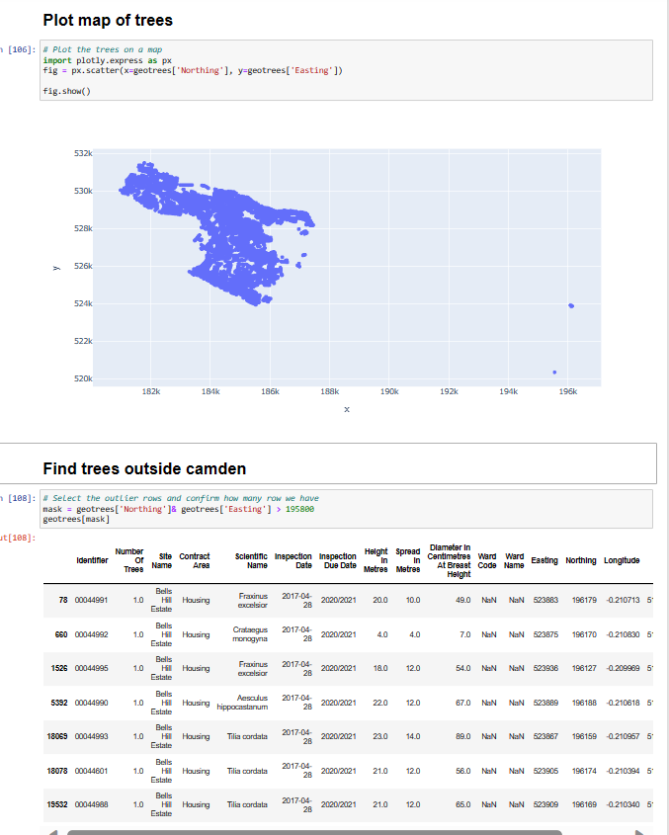
Identify Geolocations issues
In this section of my coding, I plotted a map of trees and used it to find trees which are outside Camden

Slide 14
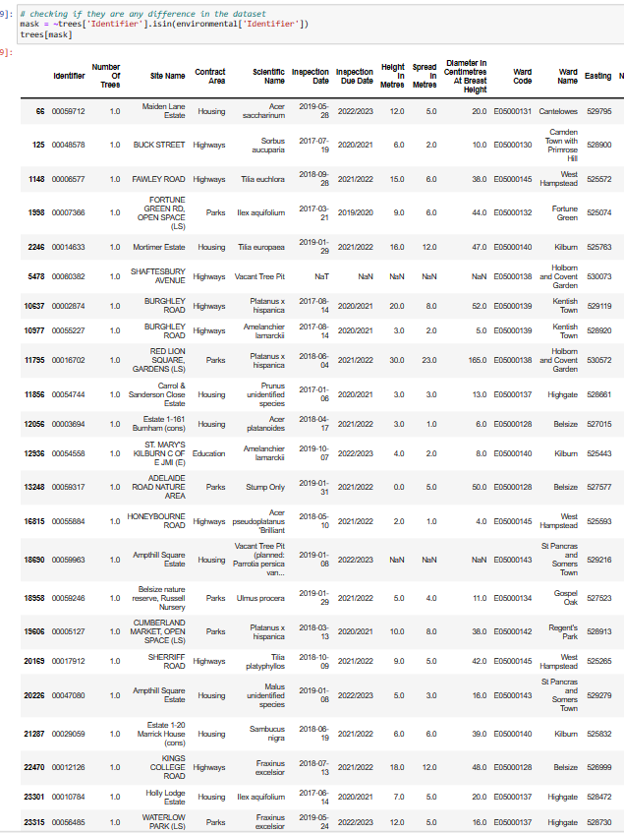
Identify Unmatched Data
From my analyisis, I Have notice that in the trees data, they are 23 data that doesn't have match with the environmental data. However, when it comes to the environmental data matching with the tree data, I can see that all the data are matching because i am not seeing any output displaying unmatching data. Furthermore,when it comes trees that doesn't match the common name data I was able to distinguish 76 data the doesn't match.

Slide 15
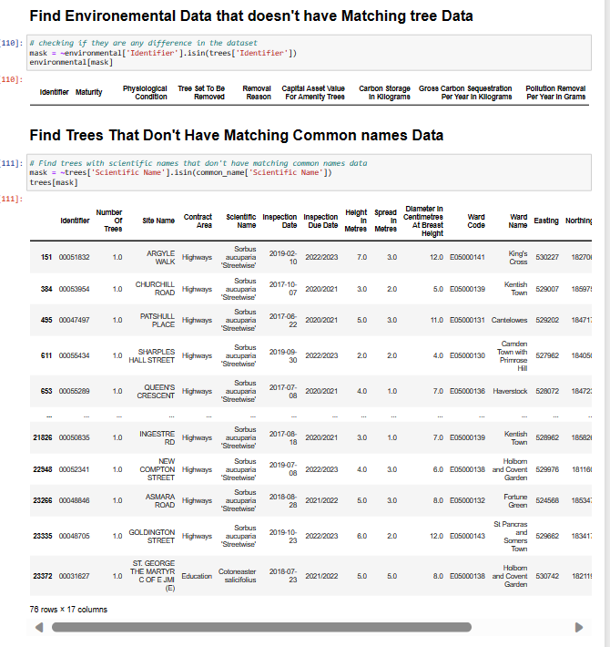
Identify Unmatched Data

Slide 16
Data Lifecyle
Acquire: extracted data from the tree files given by the Camden council, which are ”tree_common_names.json”, “Camden_trees.xlsx”, “Camden_trees_environmental.csv”.
Transform: Once the data was retrieved, the next stage was to transformed the data into a usable format.
Organised: The next stage was organising the data which wasn’t difficult because I have labelled my code to make it more understanding for others to read, and also, I have used a template which was provided by my teammate Lucas to ensure I do everything in order.
Analyse: The analysis happen when I was going trough each of 3 data sources and used visual representation so that the data could be more understandable. During, this process I have used tables, scatter plot and and box plot.
Communicate : The Data analysis which has been made would then be reported back to the Camden council so that they could take action within their other projects.
Maintain: One of the way to maintain this analysis would be to update it frequently.

Slide 17
Data requirement
Requirement | Data File | Additional Data Required | Usage
Tree Walks Brochure | Camden trees.xlsx and tree_common_names.json | For the Camden trees.xlsx , no additiontional data was required because the dataset provided enough information regarding the borough’s park and i was to see the number of three and their locations. | We can use the data to deliver on the coucils initiative such as creating a full series of tree walks brochure for walking around an individual park.
Environment Report | Camden_trees_environmental.csv and camden_trees.xlsx | No additional data was required | The dataset help me to complete the analysis of indentifying missing values, Outliers in the trees dimensions, duplicates in trees Dataset, Geoloacation issues unmatched Data.
Public Tree Data | Trees_common_common_names.json , camden_trees.xlsx and Camden_trees_environmentals.csv | No additional data was required. | The dataset help me to complete the analysis of indentifying missing values, Outliers in the trees dimensions, duplicates in trees Dataset, Geoloacation issues unmatched Data.

Slide 18
Recommendation and conclusion
What are the key data issues that could impact our ability to use this data for the three initiatives?
While going trough my analysis, I noticed that some data had missing values, and some were duplicated. This could have an impact on the three initiatives.
How big is the problem?
This could be a big issue because it could give an inaccurate reading of the analysis.
What actions can we take to improve our data?
Data Cleaning:
Standardization: Ensure consistency in formats, units, and representations across datasets.
Removing Duplicates: Identify and eliminate duplicate entries to avoid skewing analyses.
Handling Missing Values: Decide on strategies (imputation, deletion, or estimation) for dealing with missing data points.
Data Validation and Verification:
Validation Rules: Implement checks to ensure data adheres to predefined rules (e.g., range checks, format checks).
Data Governance:
Policies and Standards: Develop clear guidelines for data entry, storage, and usage to maintain consistency and integrity.
Data Ownership: Assign responsibility for different datasets to ensure accountability and maintenance.

